Slide 1

Nonverbal Delivery
Session IV. Group & Team Theory

Slide 2
Chapter outline
Nonverbal Delivery:
1. Principles of Nonverbal Communication Learning Objective
2. Types of Nonverbal Communication

Slide 3
Learning objectives
1. Demonstrate nonverbal communication and describe its role in the communication process.
2. Understand and explain the principles of nonverbal communication.
3. Describe the similarities and differences among eight general types of nonverbal communication.

Slide 4
Getting Started: Invasion of space
When someone “invades” your space, how do you feel?
Threatened, surprised, interested, or repulsed?
We can learn a lot from each other as we come to be more aware of the normative space expectations and boundaries. Set aside ten minutes where you can “people watch” in a public setting.
Make a conscious effort to notice how far apart they stand from people they communicate. Record your results.
Your best estimate is fine and there is no need to interrupt people, just watch and record. Consider noting if they are male or female, or focus only on same-sex conversations. When you have approximate distances for at least twenty conversations or ten minutes have passed, add up the results and look for a pattern.
Compare your findings with those of a classmate.

Slide 5
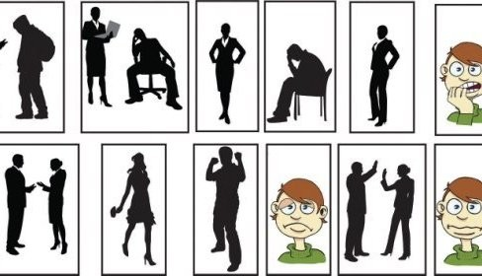
1. Principles of Nonverbal Communication

Slide 6
Nonverbal Communication Is Fluid
Nonverbal communication is the process of conveying a message without the use of words.
Include:
Gestures
Facial expressions
Tone of voice
Timing
Posture
and where you stand as you communicate.
Notes:
It can help or hinder the clear understanding of your message, but it doesn’t reveal (and can even mask) what you are really thinking.

Slide 7

Nonverbal Communication Is Fast
In the same way, we express ourself via nonverbal communication all the time without much conscious thought at all.
When a tree falls in the forest it makes a sound, even if no one is there to hear it.

Slide 8
Nonverbal Communication Can Add to or Replace Verbal Communication
People tend to pay more attention to how you say it than what you actually say.
An may ask you:
“Linh’s Beer after work?” as he walks by,
Linh simply nod and say “yeah.”
An may respond with a nonverbal gesture, called an emblem, by signaling with the “OK” sign as he walks away.

Slide 9
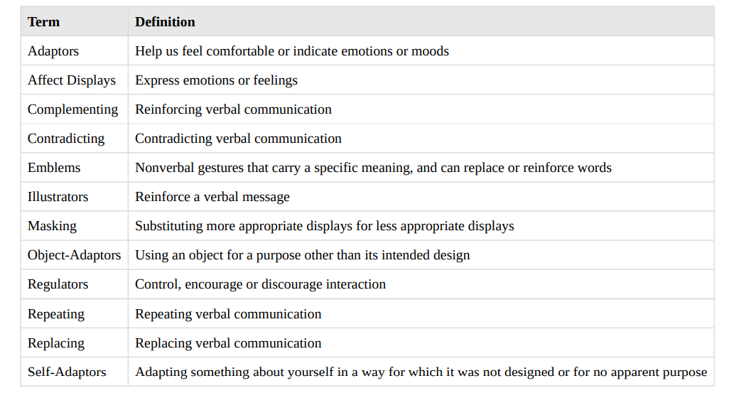
Some Nonverbal Expressions

Slide 10
Other Principles of Nonverbal Communication
Nonverbal Communication Is Universal
Nonverbal Communication Is Confusing and Contextual
Nonverbal Communication Can Be Intentional or Unintentional
Nonverbal Messages Communicate Feelings and Attitudes
We Believe Nonverbal Communication More than Verbal
Nonverbal Communication Is Key in the Speaker/Audience Relationship

Slide 11
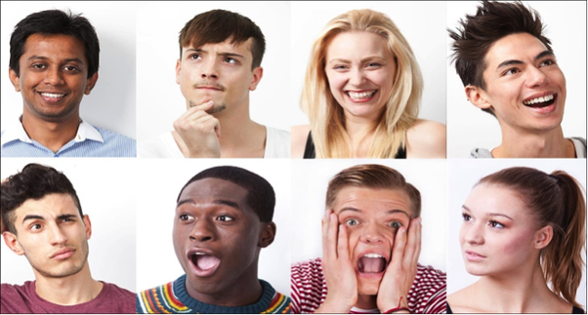
2. Types of Nonverbal Communication

Slide 12
Eight types of nonverbal communication
1. Space
2. Time
3. Physical characteristics
4. Body movements
5. Touch
6. Paralanguage
7. Artifacts
8. Environment

Slide 13
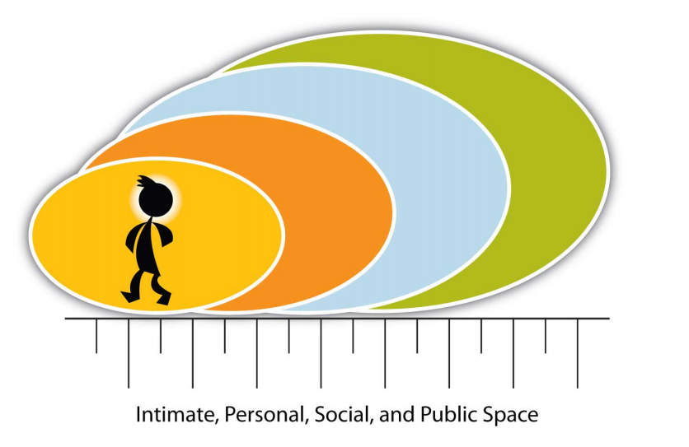
Space

Slide 14
Time
Do you know what time it is?
How aware you are of time varies by culture and normative expectations of adherence (or ignorance) of time.
Eamples:
The Euro Railways trains in Germany are famous for departing and arriving according to the schedule.
The train in Argentina, you’ll find that the schedule is more of an approximation of when the train will leave or arrive.

Slide 15
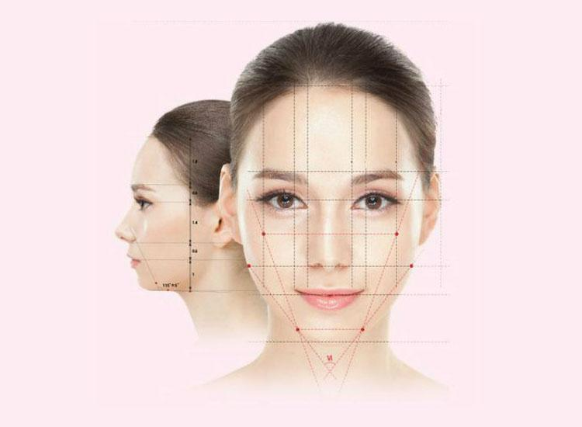
Physical Characteristics
We often make judgments about a person’s personality or behavior based on physical characteristics, and researchers are quick to note that those judgments are often inaccurate
You didn’t choose your birth, your eye color, the natural color of your hair, or your height, but people spend millions every year trying to change their physical characteristics.

Slide 16

Body Movements
The study of body movements, called kinesics, is key to understanding nonverbal communication
Four distinct ways body movements:
Complement
Repeat
Regulate
Replace

Slide 17
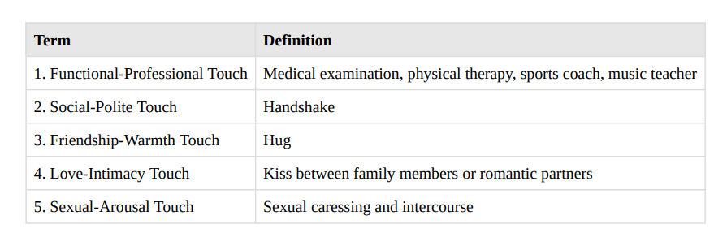
Touch

Slide 18

Paralanguage
Paralanguage involves verbal and nonverbal aspects of speech that influence meaning.
Including:
Tone
Intensity
Pausing
Silence.

Slide 19

Artifacts
Expectations vary a great deal, but body art or tattoos are still controversial in the workplace.
Do you cover your tattoos when you are at work?
Do you know someone who does?
Or perhaps you know someone who has a tattoo and does not need to cover it up on their job?

Slide 20
Artifacts
• 20 percent of workers indicated their body art had been held against them on the job.
• 42 percent of employers said the presence of visible body art lowered their opinion of workers.
• 44 percent of managers surveyed have body art.
• 52 percent of workers surveyed have body art.
• 67 percent of workers who have body art or piercings cover or remove them during work hours.

Slide 21
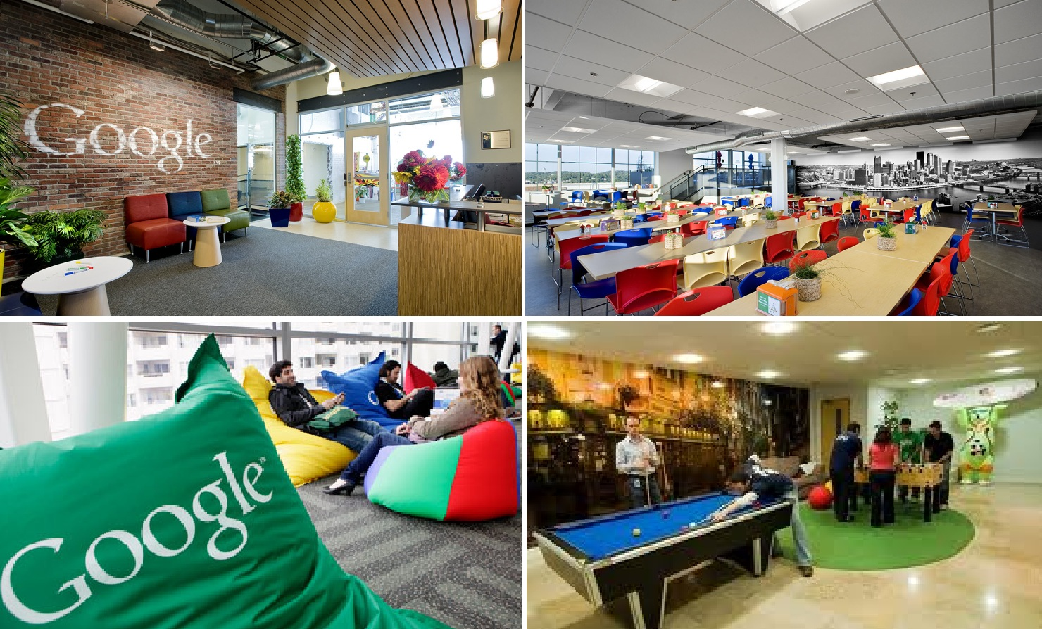
Environment
Environment involves the physical and psychological aspects of the communication context.
The perception of one’s environment influences one’s reaction to it.
For example, Google’s work environment
The results produced in the environment, designed to facilitate creativity, interaction, and collaboration, are worth the effort.

Slide 22
Activity
1. Do a Google search on space and culture. Share your findings with your classmates.
2. Note where people sit on the first day of class, and each class session thereafter. Do students return to the same seat? If they do not attend class, do the classmates leave their seat vacant? Compare your results.
3. What kind of value do you have for time, and what is truly important to you? Make a list of what you spend your time on, and what you value most. Do the lists match? Are you spending time on what is truly important to you? Relationships take time, and if you want them to succeed in a personal or business context, you have to make them a priority.
4. To what degree is time a relevant factor in communication in the information age? Give some examples. Discuss your ideas with a classmate.
5. How many people do you know who have chosen tattoos or piercings as a representation of self and statement of individuality? Survey your friends and share your findings with your classmates.

Slide 23
